Slide 1

Dashboard
Tabs: Trends for comparison, Long term plans, mid term plans, year group aims……
Classes here

Slide 2
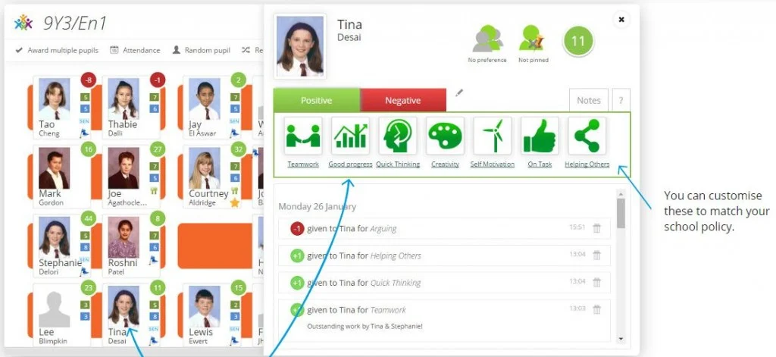

Slide 3
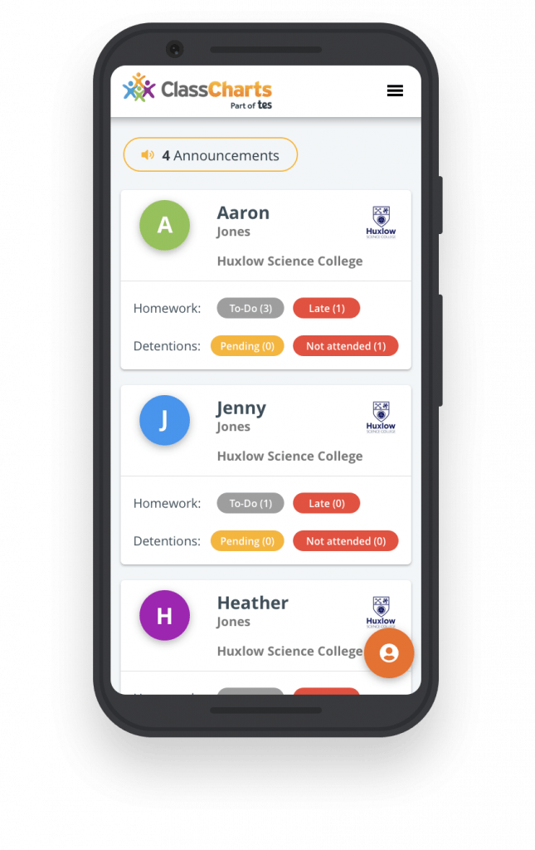

Slide 4
